Slide 1

DAY 3
Boot camp

Slide 2
DAY 3 Agenda
Topic | Topic Description | Estimated Time
Customization | Form Fields Navigation Bars Navigation Tabs Select Objects Themes Per Hostname Themes | 9am – 10:15
BREAK |  | 10:15 – 10:30
Account Administration | Creating Accounts Hooks and Keys Policy Administration | 10:30 – 12:00
LUNCH |  | 12:00 – 1:00
Asset Administration | Customizing Assets | 1:00 – 2:00
BREAK |  | 2:00 – 2:15
Event Administration | Creating and editing Event definitions | 2:15 – 4:00

Slide 3
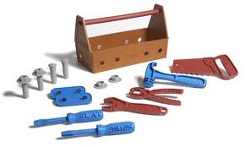
Customization

Slide 4


Objectives
Form Fields
Navigation Bars
Navigation Tabs
Select Objects
Themes
Per Hostname Themes
Resources
Labs and Questions
Customization

Slide 5

Section Overview
Customization covers the ability within ScienceLogic to add value to existing capabilities within the product. Customize ScienceLogic using various tools, from customizing the look of the user interface, to adding additional fields, tabs and navigation functions.
Customization

Slide 6
Use Case
The Challenge:
Watersports.com management has requested that they have a visual way to see which customers are active versus inactive. There is currently not an active/inactive flag on organization How would you accomplish this?
The Solution:
Create a custom form field tab called “status”
Add a Drop Down field as part of the custom tab
Use Select Objects or plus sign to populate the drop down with active or in-active options
The Results:
By downloading the “EM7 organization list” power pack off of the ScienceLogic customer portal and installing it I was able to schedule a report job that includes the active and inactive fields in the report and have it sent to management.
Customization

Slide 7

Form Fields
The ScienceLogic platform allows you to create custom fields that appear in different areas of the product.
EMBEDDED
TABBED
Custom fields associated with an embedded form appear in an existing page.
You can add embedded forms (custom fields) to the following pages:
The Ticket Editor page, in the Ticket Properties pane.
The Asset Configuration page, in the Custom Defined pane.
Custom fields associated with a tabbed form appear in that custom tab.
You can add tabbed forms (tabbed pages with custom fields) to the following panels:
Ticketing
Asset
Organization
Vendor
Customization

Slide 8
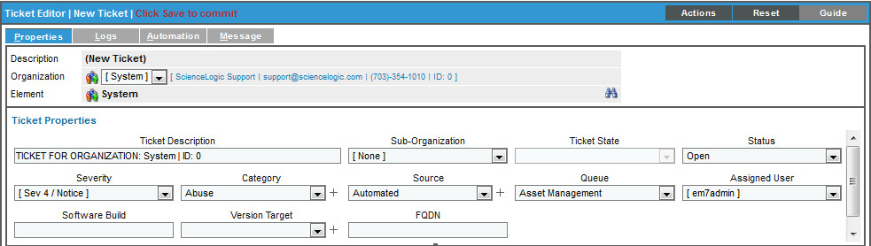

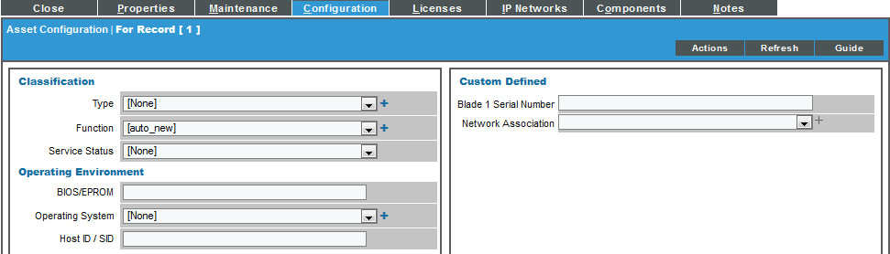
Form Fields: Embedded
Fields added to Tickets appear in the Ticket Editor Properties Tab.
Embedded Fields added to Assets appear in the Asset Configuration Tab, and are global to all assets.
Plus signs allow admins to add entries into the form
Customization

Slide 9
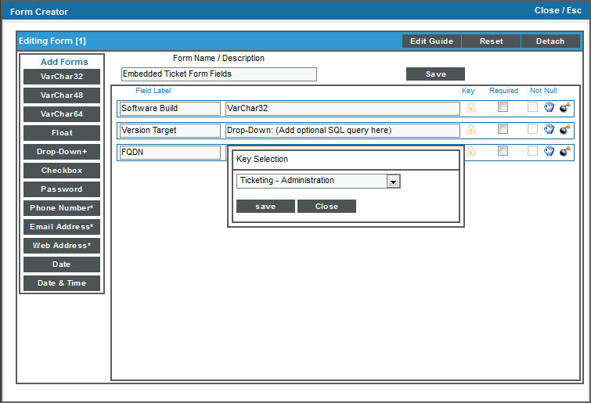
Form Fields: Create Embedded
System > Customize > Form Fields > Edit
Select the wrench for Embedded Asset or Ticket Form Fields
From the Form Creator, pick the form element on the left
Select the greyed out lock icon in order to align a Key to the field. Only users with the Key will be able to edit the field
The “hand” icon allows you to move the fields position
Not Null checkbox specifies if this field is allowed to be null
Required box indicates that the field is required in order to save the form
Customization

Slide 10
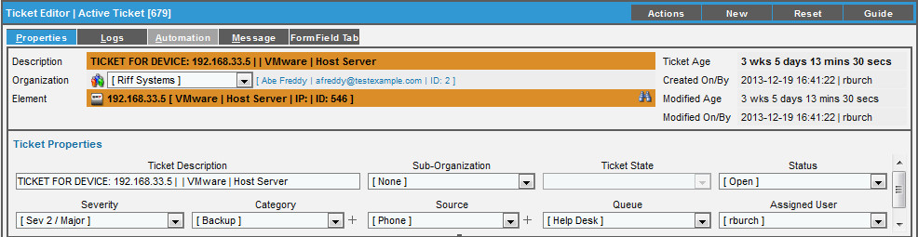
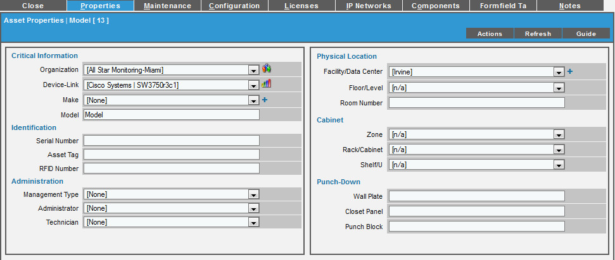
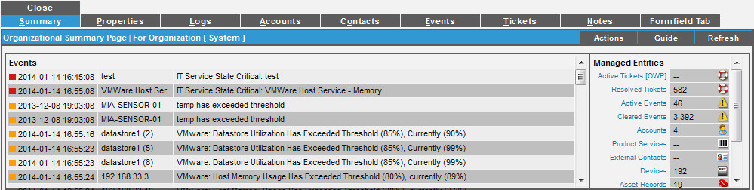
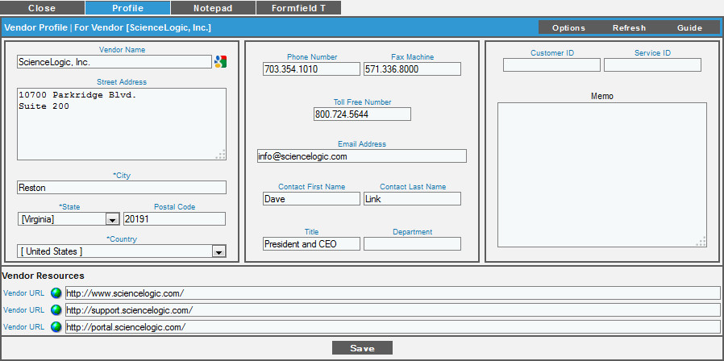
Form Fields: Tabbed
You can add Form Fields to Tabbed Forms in the following areas:
Tickets
Assets
Organization Records
Vendors
Customization

Slide 11
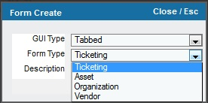
Form Fields: Create Tabbed
System > Customize > Form Fields > Create
GUI Type options are: Tabbed or Embedded (choose Tabbed)
Form Type is: Ticketing, Asset, Organization, or Vendor
Description field will be what EM7 references this tab as and is not the name of the tab in the form
Customization

Slide 12
Form Fields: Create Tabbed Cont.
System > Customize > Form Fields > Wrench
Form Name/Description is what ScienceLogic references this tab as on this page as well as on the form type (Ticket, Asset, Org, Vendor)
Tab Label is the text that will appear on the tab (16 character limit)
Edit Guide allows you to create a Guide for your custom tab page
Preview is a way to see the fields layout without having to navigate over to the feature area and away from the Form Creator.
Detach allows you to use the Form Creator in one window and see the results in the normal feature area.
Preview allows you to see what your tab is going to look like
Customization

Slide 13
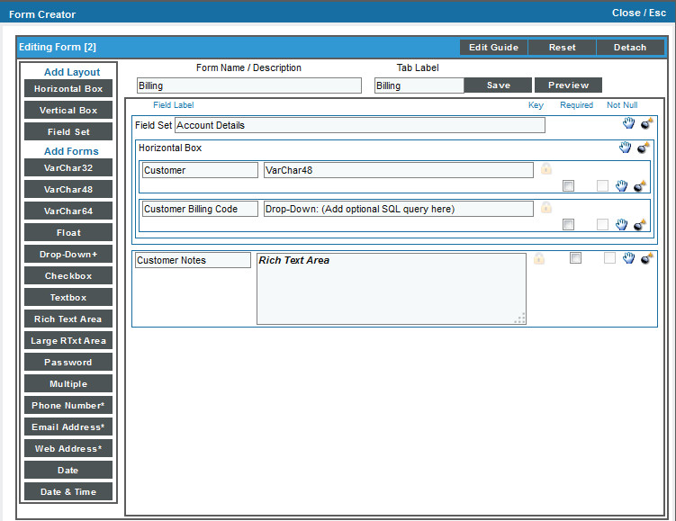
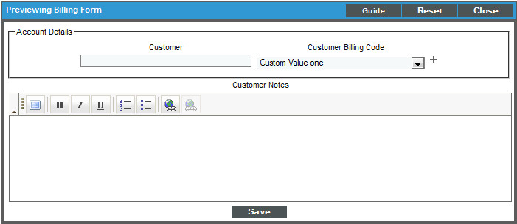
Form Fields: Tabbed Layout
Nesting layout boxes and fields allows you to build tab pages
Layout options - the type and position of one or more fields in the pane will be arranged horizontally or Vertically.
Field set – Allows definition of the box.
Add Forms - type of field to embed in the ScienceLogic page
Use the “Hand” to move fields
Can be required fields
Preview
Customization

Slide 14
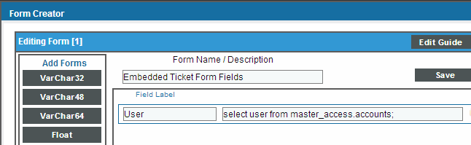
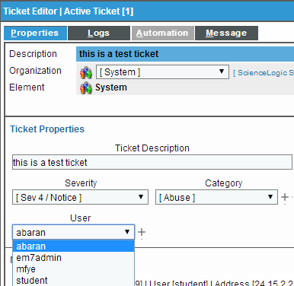
Form Field: Drop Down SQL Query
The Select Objects in a custom Drop Down form field in a Ticket, Asset, or Custom Tab can be defined with a SQL query. Using “select * from master_access.account”
ScienceLogic database query only!
Customization

Slide 15
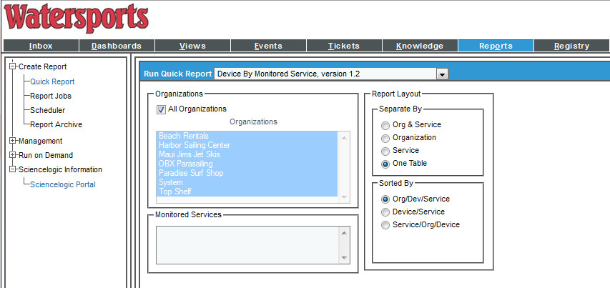
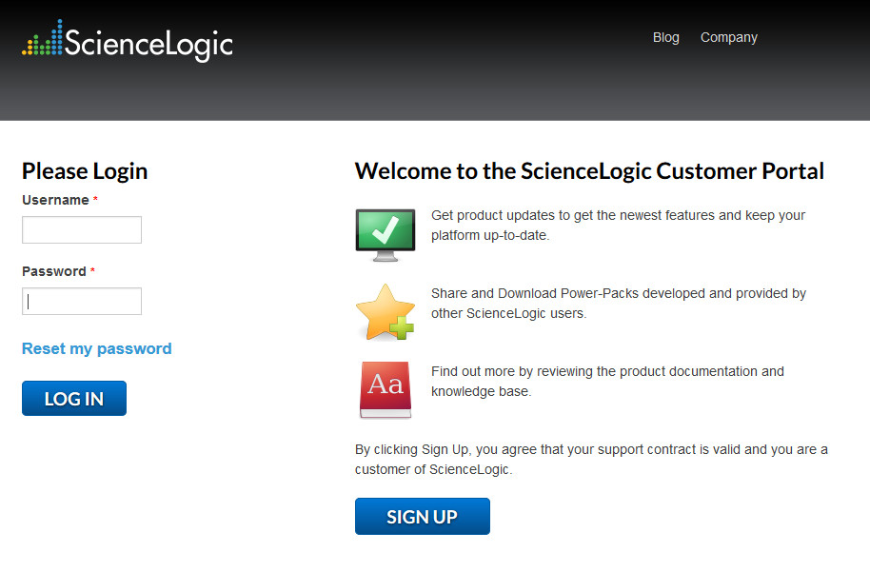
Navigation Bars
Add URL entries to quickly access external web sites or for quick access to a URL within ScienceLogic’s navigation bars.
Custom Navigation Bars appear in the following areas:
System
Registry
Reports
Preferences
Knowledge
Customization

Slide 16
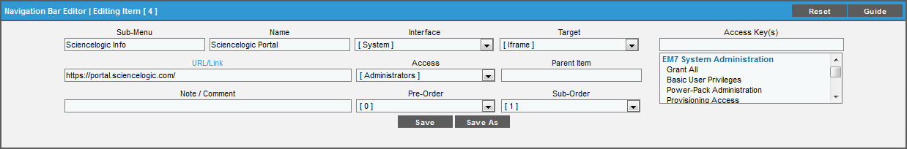
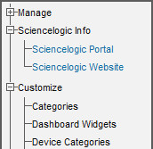
Navigation Bars: Create
System > Customize > Navigation Bars
Sub-Menu - Top-level category in the navigation bar under which the new entry will appear.
Name - Name of the link in the navigation bar.
Interface - The top-level tab in EM7 where the navigation bar entry will appear.
Target - This field specifies how the URL will be displayed.
URL/Link - The URL of the page that is displayed when a user selects the navigation bar item.
Access. Key(s) - Users who will be allowed to access the navigation bar entry.
Parent Item - This field is not currently used.
Pre-Order - Sort order for the sub-menu. The lowest numbered sub-menu appears first in the navigation bar, the highest numbered sub-menu appears last in the navigation bar.
NOTE: When you creating a new entry in an existing sub-menu, you must retain the Pre-Order value already defined for the sub-menu.
Sub-Order - Sort order for the entries in each sub-menu. The lowest numbered entry appears first under the sub-menu, the highest numbered entry appears last in the sub-menu.
Customization

Slide 17
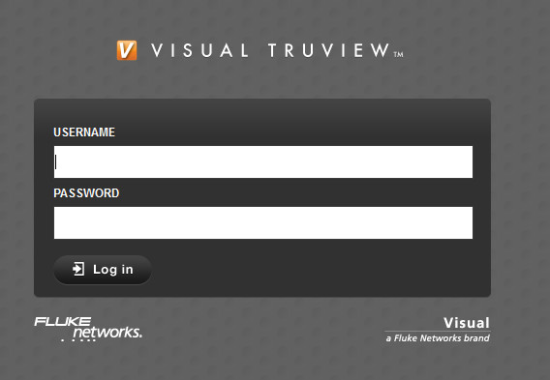
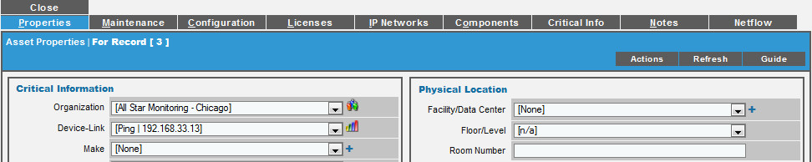
Navigation Tabs
Create new top-level tabs in ScienceLogic, Device Administration panel, Organization Administration panel, or Asset panel to launch your internal web based applications.
A new tab could contain a URL to an external control panel, to another page in ScienceLogic, or to an external website.
Added to main UI
Added to entity pages
Customization

Slide 18
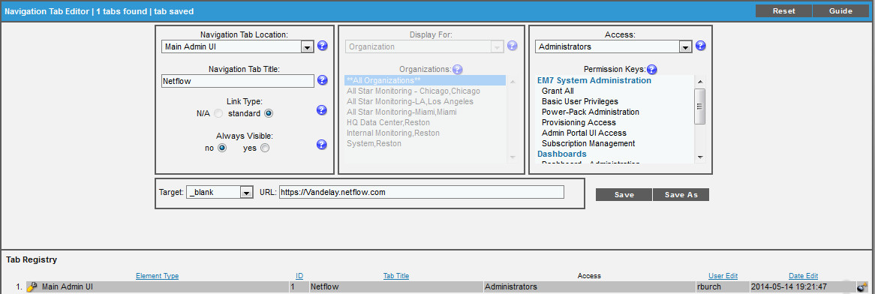
Navigation Tabs: Create Main UI Tab
System > Customize > Navigation Tabs
Delete
Main Admin UI - The new tab will appear as a top-level tab in EM7.
Navigation Tab Title - This is the text that users will see on the tab.
Link Type - For future use.
Always Visible - Specifies whether or not users who are not allowed to access the tab will be able to view the tab in EM7. Choices are:
No - Tab will not appear in the product for users who do not have the appropriate permission keys to access the tab.
Yes - Tab will always appear in the product and will be visible to users who do not have the appropriate permission keys to access the tab.
URL/Link - Full URL or link for the page that will be displayed in the tab.
Access Key(s) - Users who will be allowed to access the tab, based on the type of user account.
Access to external URL
Customization

Slide 19
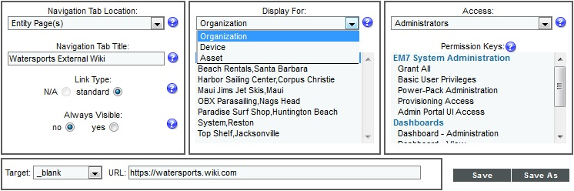
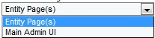
Navigation Tabs: Create Entity Page Tab
Entity Pages - The new tab will appear as part of the Organization Administration panel, Device Administration panel, or Asset panel.
Display For - In this field, you specify the area in ScienceLogic where you want to the tab to appear. Choose from:
Organization - The new tab will appear in the Organization Administration panel for selected organizations.
Device - The new tab will appear in the Device Administration panel for selected devices.
Asset - The new tab will appear in the Asset Administration panel for selected assets.
Organizations - If you selected Organization in the Display For field, Select which organizations will display the new tab.
Access to external URL
Customization

Slide 20
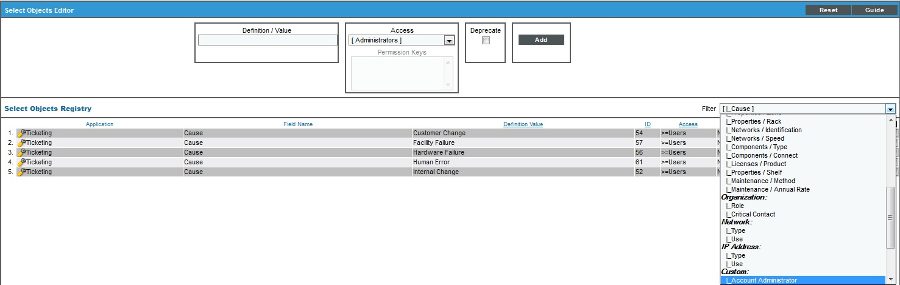
Select Objects
Define and edit the entries that appear in drop-down lists throughout ScienceLogic.
Filter will show all drop-downs that can be edited or added to ScienceLogic.
New Form Fields are selected under the “Custom” group.
Customization

Slide 21
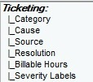
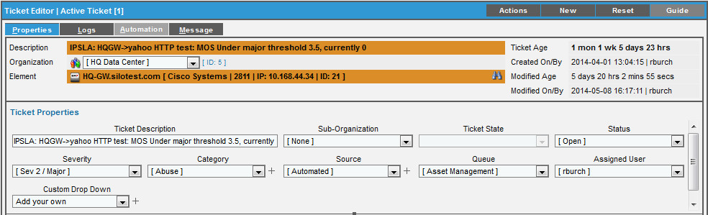
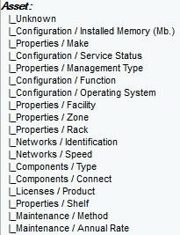
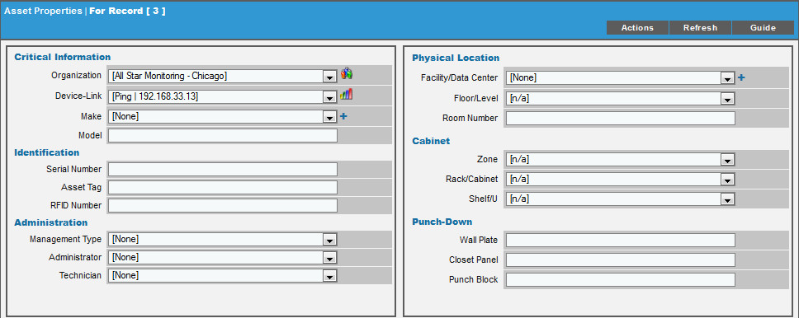
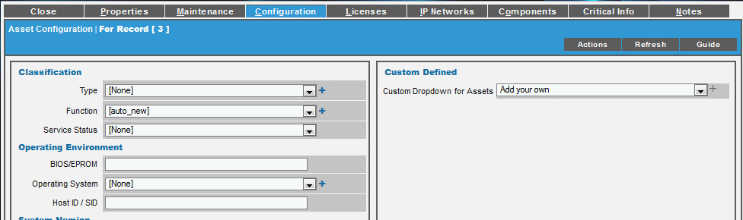
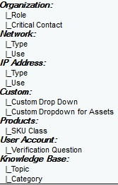
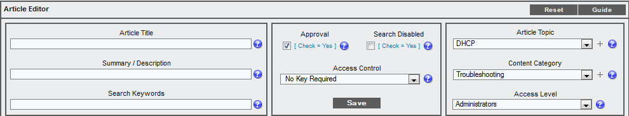
Select Objects: Where are They Used?
Plus sign allows admins to add manually while in the editor
Customization

Slide 22
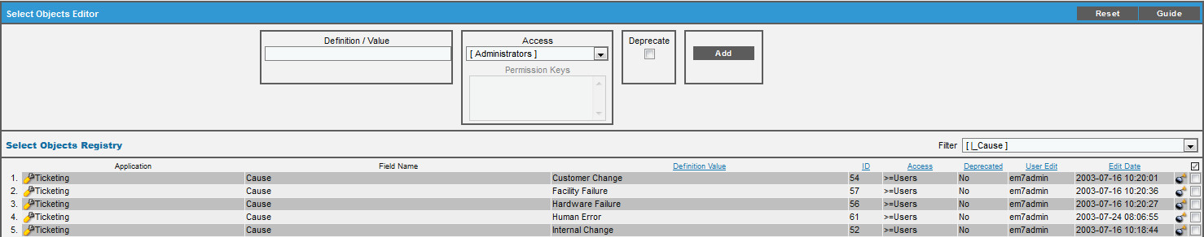
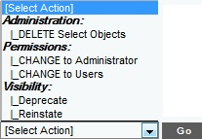
Select Objects: Dropdown and Delete
System > Customize > Select Objects
Delete Select Objects - Deletes all selected entries.
Change to Administrator - Only users with account type "administrator" are allowed to see and select each checked entry.
Change to Users+ - Both users with account type "user" and users with account type "administrator" are allowed to see and select each checked entry.
Deprecate - If you select this checkbox, each selected entry will no longer appear in the drop-down list for its field.
Reinstate - If you select this checkbox, each selected entry will no longer be deprecated. This entry will appear again in the drop-down list for its field.
Delete a single entry
Bulk Actions
Customization

Slide 23
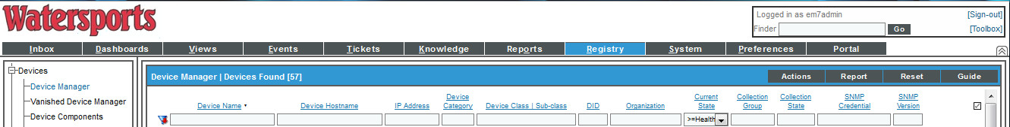
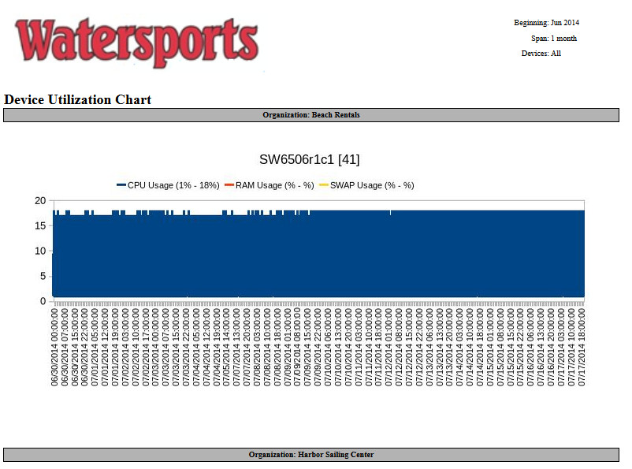
Themes
Themes are graphic templates that are applied to the GUI, and allow creation of a customized look-and-feel.
Create a corporate standard look for all employees
Create a theme per customer who accesses ScienceLogic
Change report headers
Customization

Slide 24

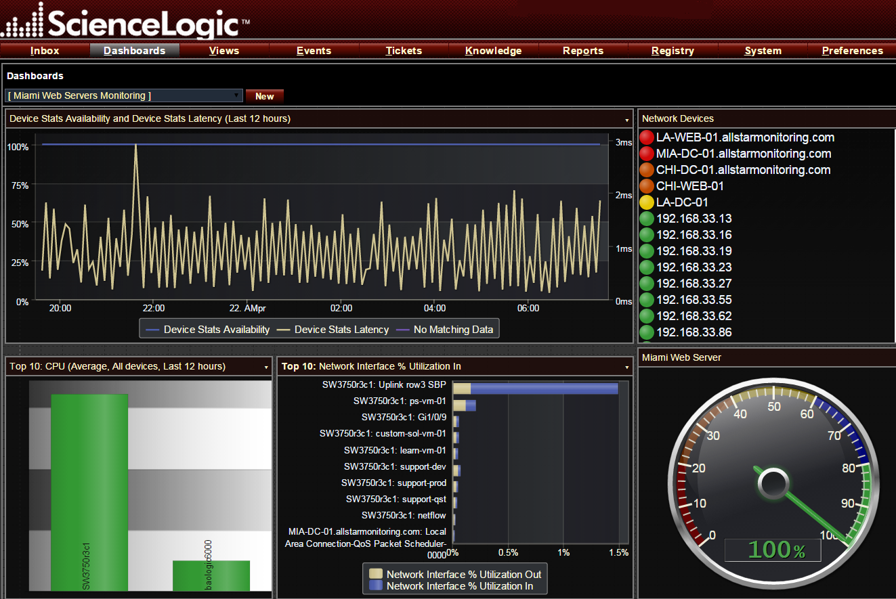
Themes: Applying
Themes can be applied from multiple places:
In the Theme Management page, select the bolt icon to immediately apply the theme to your current session.
Preferences > Account > Preferences. Select a theme in the Theme field.
Registry > Accounts > User Accounts > Create/Edit. Select a theme to be applied to another user's account.
Registry > Accounts > User Policies > Create/Edit. Select a theme to be applied to all user accounts created with the user policy.
Customization

Slide 25
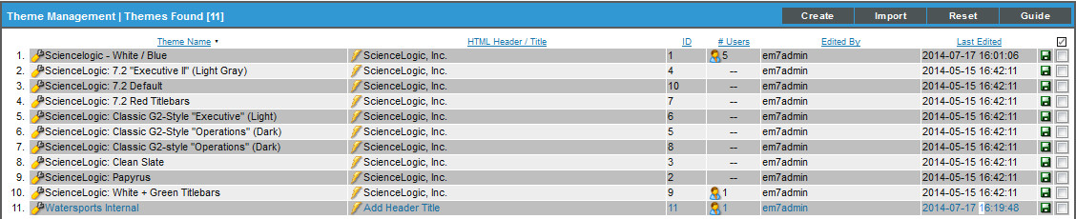
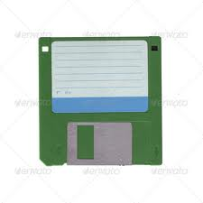
Themes: Management
System > Customize > Themes
Themes are graphic templates that are applied to the GUI, and allow creation of a customized look-and-feel for ScienceLogic. Themes can be included in Power Packs
Changes the theme
Exports Theme
Customization

Slide 26
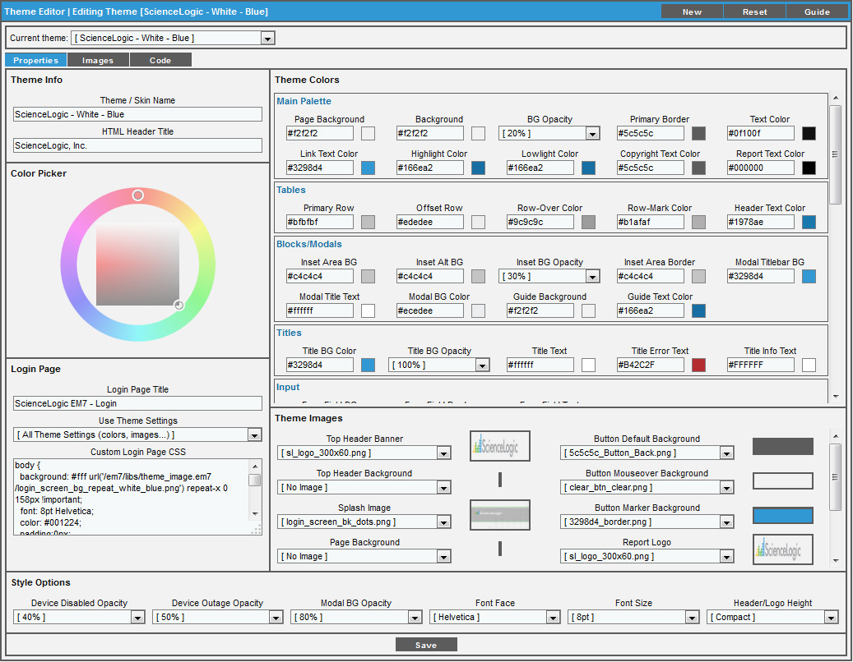
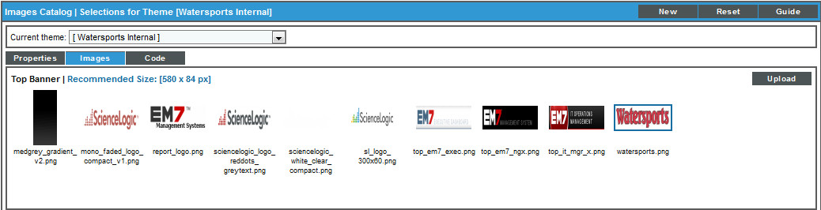
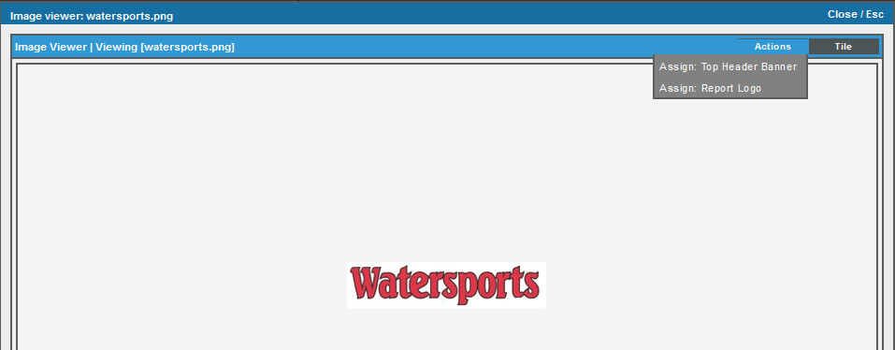
Themes: Create
System > Customize > Themes > Create
Define the colors and opacity values for user-interface elements
For fields that define colors, a thumbnail of the selected color is displayed to the right of the field.
Import your own custom logos, images, and backgrounds as a Top Banner, Splash Image, report banner or Background.
Customization

Slide 27
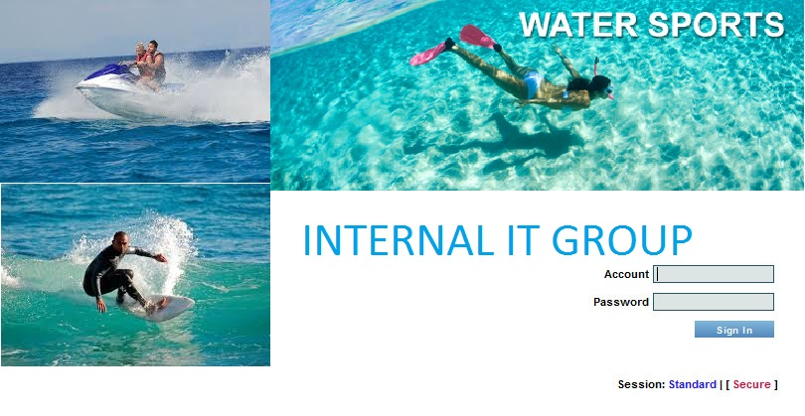

Per-Hostname Themes
ScienceLogic allows customers to provide different login screens to different customers. We do this by utilizing reverse DNS look-up and match that to a per-hostname theme policy.
Same ScienceLogic System
Customization

Slide 28
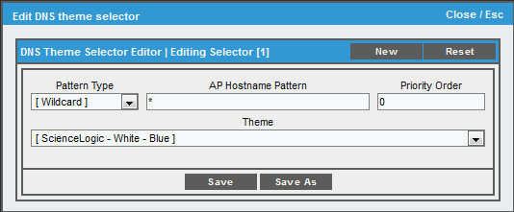
Per-Hostname Themes: Create
System > Customize > Per-Hostname Themes > Create
DNS-based theme selector rules allow you to apply themes to the login pages before a user enters an ScienceLogic username.
Pattern Type - Specifies how ScienceLogic will evaluate the value in the AP Hostname Pattern field. Wildcard for everyone, regex allows regular expressions to compare the AP Hostname Pattern to the current session information.
AP Hostname Pattern - Pattern that ScienceLogic will search for when examining the URL or IP address that the user entered in the browser to connect to the Administration Portal, Database Server, or All-In-One Appliance.
Priority Order - multiple DNS-based theme rules, ScienceLogic evaluates the rules in priority order.
Delete - Use the checkbox, and select Actions dropdown
Customization

Slide 29


Resources & Questions
For more information:
ScienceLogic Customizing
All manuals are available on the Customer Portal:
http://portal.sciencelogic.com
Customization

Slide 30

Lab
Watersports.com CEO Greg Noll has made two requests for you:
Tasks:
Provide a way to show which customers in the ScienceLogic system are active vs. inactive. To do this you will need to use some of the built-in customization capabilities in your monitoring platform. Greg would prefer this be in the form of a report that is emailed to him each Monday morning at 10am ET
Rumor has it the ScienceLogic Customer Portal is full of great information from Knowledge Base articles to Answers sections and Greg would like a one-click way to navigate to the ScienceLogic customer portal (https://portal.sciencelogic.com) from the Main UI tab of the ScienceLogic system.
Requirements:
As you attempt to fulfill requirements #1 you notice that you don’t see a field in the Organization record that states if a customer is Active, Inactive or an Internal Record. This is where you want to identify this status and you’ll have to use your new customization skills to accomplish this. (See spreadsheet next slide)
Now that you’ve crossed that bridge you need to find a suitable report to produce this new status. After checking your EM7 system you don’t come across an out-of-the-box report that provides this information but you recall seeing an email from the ScienceLogic Customer Portal where you are subscribed to receive email notices for all new Community Power Packs. The email mentioned a Power Pack called “Organization List” was submitted last week that might help your cause.
Scheduling the report to run on a weekly basis should be a breeze at this point. Make sure this is not a blank report before sending to management.
Lastly, the navigation for requirements #2 should be no problem and as you are completing that, requirements #3 comes in from Greg. They forgot to mention they want single click navigation to the Customer Portal under the Reports tab so if users need to utilize the customer portal for researching community reports then they have a quick way to access that information. The requirements is to have a new section in the left pane called “Search for Reports” with “ScienceLogic Customer Portal” underneath it.
Customization

Slide 31
These Organizations already exist on the system
Rip Curl | East Coast Boards | Ron Jon Surf Shop | K Coast Surf Shop | South End Surf
Active | Active | Inactive | Internal Record | Active
Customization

Slide 32

Account Administration

Slide 33

Objectives
Organizations
User Accounts
Access Hooks
Access Keys
User Policies
Active Directory Authentication
Resources
Account Administration

Slide 34

Section Overview
Account Administration is used in ScienceLogic to accomplish two goals, Multi-Tenant user access to data and Access Control to features:
Multi-Tenancy means that all elements in ScienceLogic go into a container called an Organization and that only Users Accounts with membership to an Organization can see that data. This is always in affect and does not need to be configured.
Access Control is additional control provided by configuring Hooks, Keys, and User Profiles. These access control components can determine what features and actions a User Account can take.
Account Administration

Slide 35
User Accounts
User Accounts can be either Individual or Policy Membership:
User Account Type
Individual
Policy Membership
Administrator
User
Policies List
Administrators:
Have access to all features and elements regardless of Organization membership
Belong to a Primary Organization and can have additional Organization membership
Users:
Subject to the Privilege Keys selected in this User Account
Belongs to a Primary Organization and can have additional Organization membership
Policy List:
This is a User Account that has been dynamically aligned or been assigned to a User Policy
Account Administration

Slide 36

User Accounts: Create
There are four ways of creating User Accounts:
Registry > Accounts > User Accounts > Create
Automatic User Account creation via LDAP/AD authentication with User Policy alignment
From an Organization Record: Actions>Add New Account
API resource “/account”
Account Administration

Slide 37
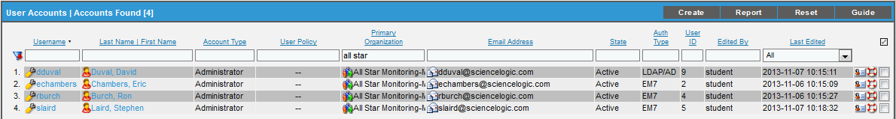
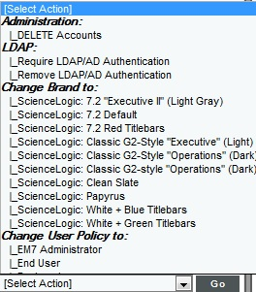
User Accounts: Registry
Registry > Accounts > User Accounts
Lists out all of the Accounts, both User and Administrator
“State” – either Active or Suspended (not allowed to log in)
Bulk Actions
Delete
Require/Remove LDAP/AD Authentication
Change Brand
Change User Policy To
Account Administration

Slide 38
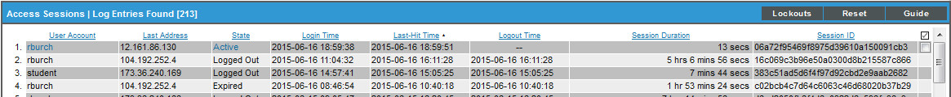
User Accounts: Access Logs
System > Monitor > Access Logs
Displays log-in user, session information, state, login time, session duration
A session can be “Killed” (Select Action). This means that the session is expired and the next time that user loads a page they will be directed to the ScienceLogic log-in page
The [Lockouts] button provides list of users currently locked out due to excessive login attempts. “Bomb” icon will remove the lockout.
Access Logs data retention set at System > Settings > Data Retention > Audit Logs
Account Administration

Slide 39
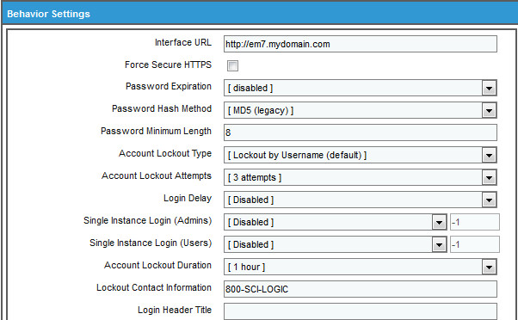
User Accounts: Lockouts
System > Settings > Behavior
Account Lockout Type – by Username, IP address, and both
Lockout Attempts – how many bad attempts before lockout
Login Delay – 1 to 10 seconds
Single Instance Login (Admins) –only one instance of the account can be logged in
Single Instance Login (Users) – only one instance of the account can be logged in
Account Lockout Duration – 1 to 24 hours
Lockout Contact Information – phone number shown to locked out users
Account Administration

Slide 40
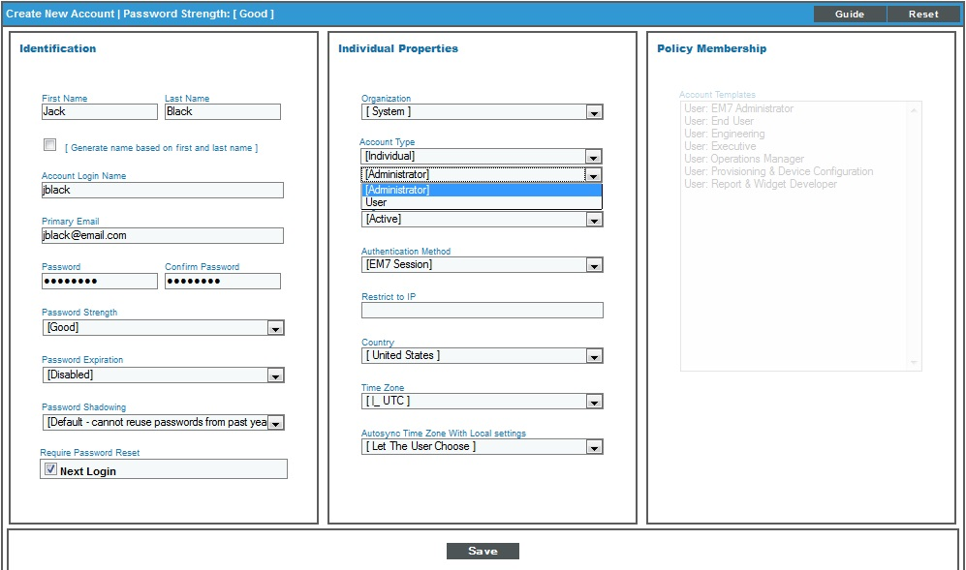
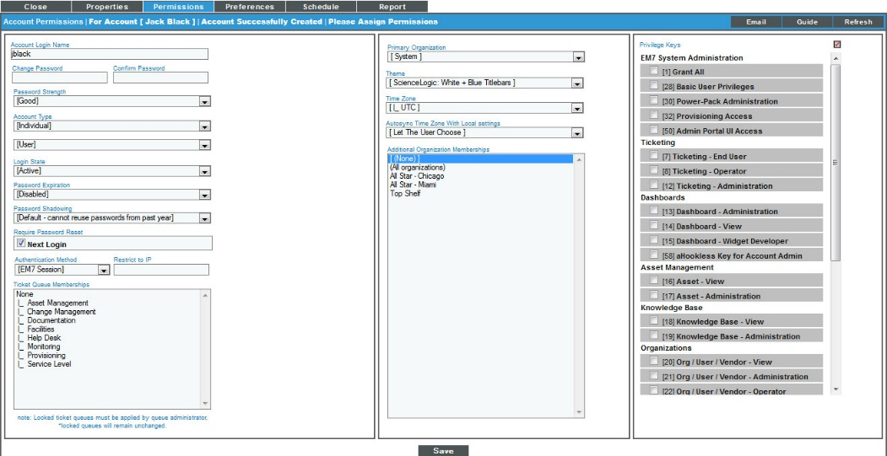
User Accounts: Create
Create a new user account from Registry > Accounts > User Accounts or from the Organizational Summary Page > Accounts Tab. Creating from the Organization will automatically associate the user with the organization from which you created the account.
The User Account Type “Individual” can select Privilege Keys
If account is Administrator, Access Key selection is not available
Account Administration

Slide 41
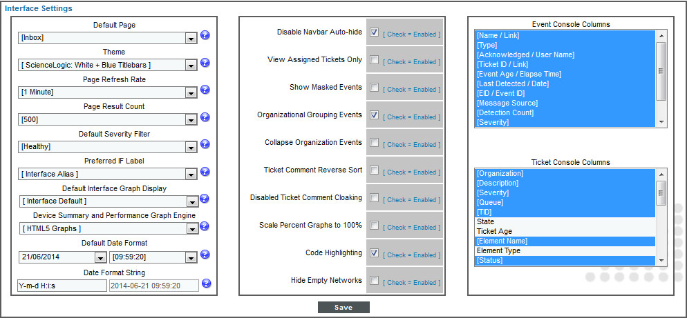
User Accounts: Preferences
Allows you to change your password and customize some of the behavior and appearance of ScienceLogic. The customizations that you choose will appear each time you login. They will not affect how ScienceLogic appears to other users.
Preferences Tab is available when creating a user and not available when creating User Policies
Account Administration

Slide 42
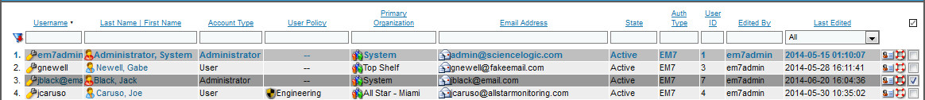

User Accounts: Delete
You can delete a user account from Registry > Accounts > User Accounts or from the Organizational Summary Page > Accounts Tab using the same method.
NOTE: When a User Account is deleted, any dashboards that belong to that user are also deleted. Dashboards that are meant for production should be created with an account that will not be deleted.
Account Administration

Slide 43

Lab
Create the following User Accounts:
Set password to “em7@student” for all accounts and leave default settings
Uncheck “Require Password Reset”
Name | Account Type | Organization | Privilege Keys
Rick Kane | Individual - User | Maui Jims Jet Skis | Asset View Dashboard View Devices Information View Basic User Privileges Admin Portal UI Access Events View Knowledge Base View Org/User/Vendor View Reporting Administration Ticketing End User
Ben Ainslie | Individual - User | Watersports.com | Grant All
Robbie Nash | Individual - Admin | Watersports.com | Administrator
Account Administration

Slide 44

Access Control
Not User Modifiable
User Modifiable
Hooks
Keys
User Policies
Access Control configuration determines what users will be able to do and see in EM7:
Access control is managed with
Hooks
Keys
User Polices
Multi-tenancy is managed with Organizations and Users
Account Administration
Notes:
Body Slide Option 2

Slide 45


Access Control: Admin vs. Restricted User
Administrator level access means all tabs and features
Restricted User shows restricted access:
Account Administration
Notes:
Body Slide Option 2

Slide 46

Access Hooks
An access hook is a granular privilege. For example, an access hook called AST_VIEW would allow a user to view asset records. AST_VIEW would not allow a user to create, edit, or delete an asset record.
Access hooks cannot be directly granted to a user account.
An access hook must be included in an Access Key, the Key is then aligned to the individual User Account or User Policy.
There are nearly 400 Access Hooks in ScienceLogic
Account Administration
Notes:
What does a hook look like?
Hooks are part of the interface code
Hooks are evaluated every time a page loads. Every time a link is clicked or refreshed all of your access permissions are validated.

Slide 47

Access Hooks: Registry
System > Manage > Access Hooks
Hooks are grouped by feature area
Some hooks are focused on overall system management and are listed as “EM7 System”
The lock icon will provide a list of Keys that have this hook
Hooks cannot be edited or deleted
Key Manager button opens the Key/Hook Alignment Editor
Account Administration
Notes:
As you can see, Access Hooks are groups around feature and functional areas. Some are clearly aligned to a feature and some to the general administration of the overall system.
They are somewhat human readable and there is a description that should clear up an questions as to what hook does
Some hooks are there just to control weather or not a tab or navigation link shows up
There are also a lot of them, currently 374 individual hooks in the system.

Slide 48

Access Keys
An access key is a group of zero or more access hooks. When you associate an access key with a user account, the user is granted all the access hooks within the key. For example, you could create an access key called "Manage Asset". That access key could include three hooks: view an asset record, edit an asset record, and create a new asset record.
Access Hooks are not aligned directly to a User Account or User Policy, they are aligned to an Access Key and then to the User Account or User Policy.
Account Administration
Notes:
Keys are a user defined collection of Hooks. Remember, hooks are defined in the code, they are not something that the user/admin has access to.
Keys are the primary organization tool of hooks and the primary way that we manage access to features.

Slide 49


Access Keys: Registry
System > Manage > Access Keys
ScienceLogic comes with a set of 29 pre-configured Access Keys
Access Keys are grouped by feature and can be edited
Users are able to create new Access Keys as needed
A key can only be deleted once it is removed from all User Policies and User Accounts
Access Keys provide graduated access to a feature, such as:
View level
Operator level
Administrator level
Account Administration
Notes:
We provide a pre-populated list of 28 access keys in EM7 out-of-the-box. This is a great starting point for your users as you build out your access control.
If we zoom in we will begin to see how the strategy is laid out for control of the features.

Slide 50

Access Keys: Key/Hook Alignment Editor
System > Manage > Access Hooks > Key Manager
The purpose of the Key Manager is to align Access Hooks to Access Keys
The [New] button is used to create a new Access Key
Key Category determines where the key appears in the navigation list
Key Category values are not editable and also determine which keys are available for selection in other areas of the product, i.e. Dashboards
The [Report] button will produce a report of the Access Hooks that are aligned to the currently displayed Access Key
A Key can be created without any Hooks in it. This is usually used to lock down a Dashboard, Device Group, Select Objects, Custom Form Fields, or Knowledge Base article
Account Administration
Notes:
Very short stop here to discuss the mechanics of interacting with the Key Manager page. It is a very flexible page, I recommend maximizing it so that the real estate available to the Unaligned Access Hooks area is as large as possible.
Things double click to move, select multiple and double click…double click the red title and all the items in it move.

Slide 51

Access Keys: Align Keys to a User
Registry > Accounts > User Accounts > Edit
The User Account Type “Individual” can select Privilege Keys
Account Type “Policy Membership” will mean Privilege Keys are not configurable on the User Account. They are managed by the User Policy.
If account is Administrator, Access Key selection is not available
Account Administration
Notes:
The User Account is where the Keys are aligned to the user
So for each User we need to select from the defined Keys in the User Account.

Slide 52

Access Keys: Grant All Key
User vs. Administrator User
ScienceLogic users that have the “Grant All” key (meaning all hooks) and ScienceLogic Administrators are very similar, however, a Grant All User:
Cannot increase their User Account to an Administrator Account
Cannot create an Administrator Account
Cannot create a Grant All key
Grant All is subject to Organization membership
Account Administration

Slide 53

Access Keys: Delete
System > Access Keys
An Access Key cannot be deleted if it has Aligned Users or Users Policies
Selection check box will only appear if the Key is allowed to be deleted.
Account Administration
Notes:
The User Account is where the Keys are aligned to the user
So for each User we need to select from the defined Keys in the User Account.

Slide 54

Access Keys: The “Hookless” key
System > Manage > Access Keys > Key Manager
A “hookless” key is a key that has been created and named, but does not have any actual Access Hooks in it. This key can be used to control access to:
Dashboards
Device Groups
IT Service policies
Custom Form Fields
The key has no hooks aligned
Account Administration

Slide 55

Access Keys: Using a Hookless key
Using a Hookless Key to lock dashboard access:
Create the Hookless Key seen on the previous screen
Go to the Dashboards tab, select the dashboard that should be restricted
Go to Actions > Configure Dashboard
Select the key from the Access Keys list and [Save]
Only users with this key will be able to see this Dashboard
Account Administration

Slide 56

Lab
Build two new keys with the following Access Hooks. Choose appropriate Key Categories:
Name | Description | Hooks
Knowledge Base – View | Grants view access to the knowledge base. | KnowledgeBase: Clipboard KnowledgeBase: Statistics KnowledgeBase: View KnowledgeBase: View Any
Devices – Information View | Grants view access to device configuration, performance data, and events. | Dev:Events Summary Dev:IF Graphs Dev:Performance Graphs Dev:View Profile Dev:View Summary Registry>Devices>Device Manager Registry>Devices>Vanished Device Manager Registry
Account Administration

Slide 57



User Policies
User Policies are a set of Account Permissions and Access Keys
The only User Preferences controlled through a User Policy are Theme and Event Console Default Display
User Accounts are aligned with a User Policy manually or through AD/LDAP
User Policy
Other User account settings:
Organization
Security
Theme
Authentication
Account Administration

Slide 58

User Policies: Create
Registry > Accounts > User Policies
Fields can be activated or deactivated
Controls the Keys for any Users aligned to the Policy
Returned Row Count is NOT an option in a User Policy
NOTE: Require Password Reset (special behavior): Field requires users to reset their password the first time that they log in, after that it is no longer required. If a change is made and the “Re-apply All Settings To All Policy Members” box is checked, then all users affected by the policy will need to reset their passwords again.
Account Administration
Notes:
The User Account is where the Keys are aligned to the user
So for each User we need to select from the defined Keys in the User Account.
Fields can be activated or deactivated (click on field label to activate)
If active, the User Policy controls the User Account setting
If inactive, the setting comes from the User Account
Controls the Keys for any Users aligned to the Policy
Returned Row Count is NOT an option in a User Policy

Slide 59

User Policies: Edit
Registry > Accounts > User Policies > Wrench
Fields can be active (bold) or inactive
If inactive, the setting comes from the User Account
Click the Label to Activate/Inactivate
Account Administration

Slide 60

Sciencelogic User Policies: Registry
Registry > Accounts > User Policies
End User – view only access to information
Operator – view and edit of most information about devices
Operations Manager – view and edit all information and has admin access to setting up how EM7 works
Executive – view only access to information and can run reports
EM7 Administrator – all access
Provisioning & Device Configuration – access to features required for device discovery
Report & Widget Developer – access to features for developing
Account Administration

Slide 61

User Policies: Manual Align
Registry > Accounts > User Accounts > Wrench User
Select the Account Type drop-down and select Policy Membership.
Select OK on the warning screen.
Drop-down below has list of policies available, select one.
Save
Account Administration

Slide 62


User Policies: Bulk Align
Registry > Accounts > User Accounts > Select Actions
Select the desired User Accounts
Use the Select Actions drop down to choose the User Policy
Hit [Go]
Account Administration

Slide 63

User Policies: Delete
Registry > Accounts > User Policies
When a User Policy is deleted the User Accounts aligned to it are not deleted:
User Account is changed from “Policy Member” to “Individual”
User Account key alignment are kept as they were from the User Policy
All fields are active, none are greyed out
Account Administration

Slide 64
Create two User Policies with these settings:
Name | Account Type | Login State | Privilege Keys
Customer | User | Active | Basic User Privileges Ticketing End User Dashboard View Asset View Org/User/Vendor View Reporting-Run Quick Reports Events view Devices-Information View
Operations | User | Active | Grant All
Leave the rest of the fields with their default settings.
Account Administration

Slide 65
LDAP/AD Authentication
The LDAP/AD Authentication feature allows EM7 to query a specified Directory server to authenticate a user.
Services a single domain
Credential can have multiple authentication servers listed (comma separated list)
Can synchronize user account attributes from LDAP/AD to ScienceLogic and/or ScienceLogic to LDAP/AD
Based on a single attribute value a User Policy can be aligned upon login
Automatically creates user accounts that match policy alignment
Administrators of ScienceLogic systems will need to decide what Attribute of a User Account record in Active Directory will determine User Policy membership in ScienceLogic.
Account Administration

Slide 66
Use Case
The Challenge:
Having an authentication integration where end users in the environment can login and receive an account auto created with the appropriate EM7 permissions.
The Solution:
Create an Active Directory credential for the corporate Active Directory system
Create User Policies set to LDAP/AD authentication
Enable EM7 LDAP/AD features to create accounts, align User Policies, import user data, and authenticate users
The Result:
Any user in the environment can now login with their domain credentials and be placed in the appropriate user policy which enforces access rights.
Account Administration

Slide 67
Active Directory Authentication Options
Do not import new users from directory
User account must already exist in EM7
User Account Authentication Method is set to “LDAP/Active Directory”
AD Credential must exist in EM7
AD settings type is “Do not import new users from directory”
AD used for authentication and the User Account settings are determined by User Account
Static Policy Alignment
User Account does not need to exist in EM7
Single User Policy with Authentication Method set to “LDAP/Active Directory”
AD Credential must exist in EM7
AD Setting type is “Static Policy Alignment”
If user does not exist it is automatically created in EM7 upon first successful login
AD used for authentication and the User Account settings are determined by the aligned User Policy.
Dynamic Policy Alignment
User Account does not need to exist in EM7
Multiple User Policies with Authentication Method set to “LDAP/Active Directory”
AD Credential must exist in EM7
AD Setting type is “Dynamic Policy Alignment”
If user does not exist it is automatically created in EM7 upon first successful login
AD used for authentication and the User Account settings are determined by the first matching Attribute/Value mapped User Policy
Account Administration

Slide 68

Active Directory Authentication
User types in username and password on EM7 Login page
EM7 uses the AD Credential User Name to read Active Directory to find the user account
If account exists in EM7 and the user has supplied a valid password, they are authenticated and allowed to log into EM7
If they do not exist in EM7 and they have a AD account with matching attribute value then EM7 creates the account, synchronizes mapped attribute information, and aligns the user to a User Policy based on the value (AD attribute value) aligned with the user policy in the LDAP/AD settings
Account Administration

Slide 69
Active Directory Authentication: Requirements
Using Active Directory authentication with ScienceLogic requires that the following components be configured:
ScienceLogic Configurations:
A LDAP/AD Credential in ScienceLogic One or more User Policies with the setting Authentication Method = LDAP/Active Directory Define the ScienceLogic LDAP/AD settings Basic Settings Attribute Mapping Importing Users – Policy Alignment Access to TCP port 389 on the Active Directory server from one of these ScienceLogic appliances: All-In-One Administration Portal Database/Administration Portal
LDAP/AD Configurations:
Valid user account in AD Provide an Attribute Name that will be used to map to the User Policy Provide an Attribute value so that ScienceLogic can map a User Policy to it
Account Administration

Slide 70




Active Directory Authentication: Requirements
AD: LDP tool to find Attribute Name
AD: User Account populated with Attribute Value
AD Settings - Define the Attribute Name and Value
User Policy set Authentication Method
Account Administration

Slide 71

Active Directory Authentication: Credential
System>Manage>Credential>Create>LDAP/AD Credential
Account Administration
Notes:
System>Manage>Credential>Create>LDAP/AD Credential
Profile Name – this name that will be referenced in EM7
LDAP Type – Active Directory or LDAP
Hostname/IP – IP of the AD server (comma separated list for multiple servers)
Port / Secure
“no” = LDAP on port 389
“yes” = LDAPS on port 636 (required SSL Certificate)
RDN (Bind DN/bind user) – use “%u@%d”, these are internal EM7 variables that will be substitutes with the actual values at the time of the AD request
LDAP Domain – supply the name of Domain
Bind Password – Password that allows access to the Active Directory server or the LDAP server. In most cases, when you specify a bind password in a credential, you are creating a "write" credential for when EM7 synchronizes to the LDAP/AD server.
User Search Base – defines what part of the AD directory tree to search for the user. i.e. dc=Company,dc=local
User Search Scope – “subtree” or “one level”, this is used to limit the search in the User Search Base

Slide 72





Active Directory Authentication: Ldp.exe
All Windows Active Directory servers include a tool that can be used to browse the directory tree. This tool is a good way to find and copy the text string that ScienceLogic will use to map to a Attribute and Value when mapping an account to a User Policy.
Use the Start button and search for the term “ldp”. Click to start the application
Drop down the “Connection” menu and select “Connect”
Enter Active Directory server IP or name here.
Once connected, enter the user/pwd into the Bind dialog
Account Administration

Slide 73



Active Directory Authentication: Ldp browser
Use the “View” menu and select “Tree”
Select “OK”
Navigate to a User Account to get Attribute name and value
Account Administration

Slide 74
Active Directory Authentication: Settings
System>Settings>LDAP/AD Authentication
Once the Credential has been created, EM7 needs to be configured to use it.
EM7 Field | AD Attribute | EM7 Field | AD Attribute
First Name | givenname | Primary Email | mail
Last Name | sn | Secondary Email | blank
Title | blank | Street Address | streetaddress
Department | department | Suite/Building | blank
Phone | telephonenumber | City | l
Fax | facsimiletelephonenumber | State | st
Mobile | mobile | Postal Code | postalcode
Pager | pager | Country | c
Account Administration
Notes:
Once the Credential has been created, EM7 needs to be configured to use it.
Basic Settings:
Read Credential – this is the AD credential that was created
Write Credential – only used if syncing values from EM7 to AD
Search Filter – uses “samaccountname=%u” or “%e”. %u = email prefix/EM7 username and %e = complete email address
Sync directory values to EM7 on login – allows the EM7 account to be updated if there are any changes to the AD account. Settings are enable/disable.
Attribute Mapping – if “Sync directory values…” set to “enable” these are the values that can be synced

Slide 75


Active Directory Authentication: Importing Users – Policy Alignment
System>Settings>LDAP/AD Authentication
When ScienceLogic creates a new user account it will need to put it into a User Policy. This is configured in the “Importing Users – Policy Alignment” section of the page.
Account Administration
Notes:
Type
Do not import new users from directory – authentication only, EM7 will automatically make accounts
Static policy alignment – all imported accounts will be set to the one specified User Policy
Dynamic policy alignment – *Option only available if two or more User Policies are defined. imported accounts will be set to one of multiple User Policies based on a match between an Active Directory attribute and the User Policy
Attribute – This is the field in the LDAP/AD directory that you want to key off of for User Policy alignment.
Value – one or more lines defining the value of the attribute and the Policy that it maps to. i.e the attribute is “department” and one value is “operations” mapping to the Operations Policy and another value can be “customer” mapping to the End User Policy.

Slide 76
Resources and Questions
For more information:
Organizations and Users Manual
Active Directory and LDAP Configuration
Guide Button
Reports and Dashboard Widgets
Access Hooks and Keys
API
All manuals are available on the Customer Portal:
http://portal.sciencelogic.com
Account Administration

Slide 77
Reports and Dashboard Widgets
Type | Name | Description
Embedded Report | Organization Registry Report button | Provides report of the current Organization registry page taking into account any sort criteria as an Excel spreadsheet
Embedded Report | Organization Registry Printer icon | Provides report on the specific Organization in-line with the Printer icon HTML, Excel, ODF, or PDF output
Embedded Report | User Accounts Registry Report button | Provides report of the current User Accounts registry page taking into account any sort criteria as an Excel spreadsheet
Embedded Report | User Accounts Registry Printer icon | Provides report on the specific User Accounts in-line with the Printer icon HTML, Excel, ODF, or PDF output
Embedded Report | Access Keys Report button | Provides a report of the selected Access Key detailing the Hooks that included in it. Output is in Excel spreadsheet.
Dashboard Widget | (base) Custom Table | Custom table widget of Entity Type “Organization”
Dashboard Widget | (base) Custom Table | Custom table widget of Entity Type “Contact”
Account Administration

Slide 78
Access Hooks: Organizations
Hook_id | Name | Description
ORG_ADDREM | Org:AddRem | Create new orgs or delete orgs of which the user is a member
ORG_ALT_LOCATIONS_EDIT | Org:AltLocations:Edit | Edit the alternate locations of an org
ORG_CLEAR_LOGS | Org:Logs:Clear | Clear logs for an organization of which the user is a member
ORG_EDIT | Org:Edit | Edit the properties of an org
ORG_LOGS_VIEW | Org:Logs:View | View logs for an org
ORG_NOTE_ADDREM | Org:Notes:Add/Rem | Add/Remove notes for an org
ORG_NOTE_EDIT | Org:Notes:Edit | Edit notes for an org
ORG_NOTE_VIEW | Org:Notes:View | View notes of an org
ORG_PRINT_REPORT | Org:Print Report | Generate a printable report of orgs from the registry page
ORG_REG_PAGE | Registry>Accounts>Organizations | Access the Organizations registry page
ORG_SUMMARY_VIEW | Org:View Summary | View the Summary information for an org
ORG_VIEW | Org:View | View the properties of an org of which the user is a member
Account Administration

Slide 79
Access Hooks: User Accounts
Hook_id | Name | Description
ACT_EMAIL_SUB_ADDREM | External Contact:Add/Rem | Add or Remove an External Contact
ACT_EMAIL_SUB_EDIT | External Contact:Edit | Edit an External Contact
ACT_EMAIL_SUB_ORG_VIEW | External Contact:View (From Org Page) | View an Email Subscriber from the Org properties page
ACT_EMAIL_SUB_REG_PAGE | Registry>Accounts>External Contacts | Access the External Contacts registry page
ACT_EMAIL_SUB_VIEW | External Contact:View | View an External Contact's Information
ACT_MY_INFO_PAGE | Preferences>Account>Information | Access 'My Info' Page
ACT_MY_PAGE | Preferences> | Prerequisite check for all Preferences>* pages (needed in addition to specfic page rights)
ACT_MY_PREFERENCES_PAGE | Preferences>Account>Preferences | Access the 'My Preferences' Page (can be accessed from the Toolbox without Preferences> hook)
ACT_MY_RSS_PAGE | Preferences>Desktop Tools>RSS Feeds | Access the 'RSS Feeds' Page
ACT_MY_SCHEDULE_PAGE | Preferences>Account>Schedule | Access the 'My Schedule' Page
ACT_ORG_USER_EDIT | User:Edit (From Org Page) | Edit a user from the Organization properties page
ACT_USER_ADDREM | User:Add/Rem | Add or Remove an EM7 user account
Account Administration

Slide 80
Access Hooks: User Accounts (cont.)
Hook ID | Name | Description
ACT_USER_EDIT | User:Edit | Write access to EM7 user accounts, not including add/remove
ACT_USER_POLICY_ADDREM | User Policy:Add/Rem | Add or remove a User Policy
ACT_USER_POLICY_EDIT | User Policy:Edit | Edit a user policy
ACT_USER_POLICY_REG_PAGE | Registry>Accounts>User Policies | Access the User Policies registry page
ACT_USER_POLICY_VIEW | User Policy:View | View a user policy
ACT_USER_PRINT_REPORT | User:Print Report | Print a report for a given user
ACT_USER_REG_PAGE | Registry>Accounts>User Accounts | Access the User Accounts registry page
ACT_USER_VIEW | User:View | Read access to EM7 user accounts
ACT_VENDOR_ADDREM | Vendor:Add/Rem | Add or Remove a Vendor account
ACT_VENDOR_EDIT | Vendor:Edit | write access for Vendor acounts, not inlucding add/remove
ACT_VENDOR_NOTES_EDIT | Vendor:Edit Notes | write access to Vendor Notes
ACT_VENDOR_NOTES_VIEW | Vendor:Notes | View the Notepad tab on the vendor pop-up
ACT_VENDOR_REG_PAGE | Registry>Accounts>Vendors | Accesss the Vendors registry page
ACT_VENDOR_VIEW | Vendor:View | Read access to vendor accounts
Account Administration

Slide 81
Included Keys
Included Organization/User Account Keys:
Org/User/Vendor – View | Grants view access to organizations, user accounts, external contacts, and vendors
Org/User/Vendor – Administration | Grants add, edit, remove permissions for organizations, user accounts, external contacts, and vendors
Org/User/Vendor – Operator | Grants view access to organizations, user accounts, external contacts, and vendors, and the ability to add/edit organization and vendor notes
Account Administration

Slide 82
API Resource: Organization
Organization API Resources:
https://youripaddress/api/organization
Address | Billing_id
City | Company
Contact_fname | Contact_lname
Country | Crm_id
Date_create | Date_edit
Dept | Email
Fax | Longitude
Latitude | Notifications_append
Phone | State
Theme | Title
Tollfree | Updated_by
Updated_by/user | Zip
Account Administration

Slide 83
API Resource: Account
Accounts API Resources:
https://youripaddress/api/account
Active | Address | Admin | All_orgs | Autodetect_timezone | Barred | Passwd_expiration
Billing_id | Cell | City | Codehightlight | Console_height | Contact_fname | Passwd_prev_count
Contact_lname | Country | Create_date | Created_by | Critical | Crm_id | Passwd_reset_required
Date_format | Default_map | Default_map_type | Dept | Dev_html5_graph | Edit_date | Passwd_set_date
Email | Email_2 | Email_3 | Evetn_severity | Events_default_view | Fax | Passwd_strength
If_graph_perc | Iflabel_pref | Im | Im_type | Ldap | Login_state | Zip
Notes | Office | Organization | Page_results | Pager | Passwd | Verification_question
Recent_timezone | Refresh | Restrict_ip | Role | State | Theme | Ticket_note_sort
Timezone | Title | Tollfree | Updated_by | User | User_policy | Verification_answer
Account Administration

Slide 84
Lab
Task:
Up to this point all of the accounts have been EM7 Session Authenticated accounts. Now it is time to move all Watersports user accounts onto Active Directory authentication. New Watersports employees will need to have their accounts automatically created so that they fall into either the Sales or Operations User Policies.
Requirement:
Set up access methods to meet all of the requirements in this table. The new users Nat Young and Dane Reynolds will be created through the AD integration to demonstrate the automatic account creation and User Policy mapping. Ben Ainslie is a one-off customer with unique access rights.
Org | User | Dashboard | Ticket | Event | AD/EM7 Session | User Type
Watersports | Robbie Nash | All | All | All | EM7 Session | Individual: Admin
Watersports | Nat Young | All | All | All | AD Auto Create | Policy: Operations
Watersports | Dane Reynolds | View | View | View | AD Auto Create | Policy: Sales
Beach Rentals | Ben Ainslie | View and Edit Dashboards | View | View and Acknowledge | EM7 Session | Individual: User
Maui Jims Jet Ski’s | Rick Kane | Surf Report only | None | All | EM7 Session | Policy: Customer
Account Administration

Slide 85
Lab Tools
This is a checklist of items that will help accomplish the lab:
User accounts
Individual – User or Admin
Policy Membership
User Policies
Create new user policy Sales: settings according the spreadsheet
Operations: should have “Grant All” key, all Ticket Queues, Primary Org of “Watersports”, Additional Organizations of “All Organizations”, and other default account settings
Customers: what is specified in the spreadsheet
AD Credential
Domain: watersports.com
Hostname/IP: 192.168.33.208
User Search Base: dc=watersports,dc=com
RDN (Bind DN / bind user) : %u@%d
The attribute values in the AD records are “Sales” and “Operations”
Once everything is configured, these new accounts should be created just by logging in with these credentials (they already exist in the AD server):
Nat Young
Username: nyoung
Password: em7@student
Dane Reynolds
Username: dreynolds
Password: em7@student
Test all access by logging in as each user to verify that access rights and policy alignment are correct.
Account Administration

Slide 86

Asset Administration

Slide 87
Objectives
Automatic Asset Creation
Asset/Form Link
Customizing Assets
Resources
Labs and Questions
Asset Administration

Slide 88

Section Overview
Asset Management provides a way create and track Asset information in ScienceLogic . Asset records are independent records and can be used for devices that are being monitored by ScienceLogic and for other assets such as phones, software licenses, chairs, etc…
Asset records can be created manually or automatically. Additionally, ScienceLogic can be configured to populate some asset fields with data collected from monitored devices.
Asset records can be customized to fit your operation with tabbed forms, embedded form fields, and reporting.
Asset Administration

Slide 89
Use Case
The Challenge:
You need to report and track the BIOS versions from your Dell servers.
The Solution:
Find or create the Configuration Dynamic Application to collect the Dell BIOS version
Configure the Asset/Link field in the Dynamic Application to populate the Asset record with BIOS information
Schedule a Report Job for the Asset List report to be delivered monthly
The Results:
A monthly Asset List report of all Dell servers including BIOS version information is scheduled and sent to the System Administrator manager for review.
Asset Administration

Slide 90

Asset: Asset Manager
The Asset Manager provides access to all assets and includes at-a-glance information on some asset information.
Note that the Asset Organization for a device asset can be different than the Device Organization.
A service provider may own and maintain the asset which is for a device that has been provisioned in a specific customer organization
The customer will not see the Asset Record because the Asset Record is in the service providers organization, not the customers
Asset Administration

Slide 91

Asset: Automatic Creation
System > Settings > Processes >“Enterprise Database: Asset Record Maintenance” process
ScienceLogic can create assets automatically based on information from the device. By default this process is not enabled, when enabled it will create an asset record for all devices including:
Devices
Component Devices i.e. VMware Datastore or NetApp volume
Virtual Devices (Device Manager > Actions > Create a Virtual Device)
This is a global setting
Process frequency: 1 hour
Asset Administration

Slide 92



Asset: Asset/Form Link
Automatically populates the Asset record for a device using data collected by configuration Dynamic Applications.
Asset Administration
Notes:
Automatically populates the Asset record for a device using data collected by configuration Dynamic Applications.
Asset Fields Available:
Make
Model
Serial Number
Operating System
Host ID / SID
OS System Name
CPU Count
CPU Type / Make
CPU Speed
Firmware / BIOS Name
Installed Memory
Asset Tag
Disk Array Size
Disk Count
Disk Size
All Custom Fields are also available
Automatic updates require that the Enterprise Database: Asset Record Maintenance process be enabled on the System > Settings > Processes page

Slide 93

Asset: Asset/Form Link
System > Applications > edit a Config App Collections tab
Collected values from a Configuration Dynamic Application can populate Asset Fields:
Asset item will populate the standard asset fields
Form Link item will populate a custom embedded Asset field
Asset Administration

Slide 94

Assets: Asset Automation Settings
System > Settings > Assets
The Asset Automation page allows you to define the default behavior for all asset records. For each standard asset field, you can specify:
Whether the field is populated and updated by auto discovery.
Whether the field is populated and updated using information from configuration Dynamic Applications.
Whether or not ScienceLogic should generate an event if the field’s value changes.
The defined behavior will be applied to every asset record in ScienceLogic.
Asset Administration

Slide 95


Assets: Customizing
Embedded Custom Form Fields appear on the Configuration tab
Navigation Tab
Tabbed Form Fields
Asset Administration

Slide 96


Assets: Bulk Actions
The Select Actions drop down on the Asset Manager page allow you to set the following asset fields:
Organization
Function
Status
Owner
Location
Asset Administration

Slide 97
Resources and Questions
For more information:
Assets and Vendor Adminstration Manual
Guide Button
Reports and Dashboard Widgets
Access Hooks and Keys
Process, System Settings, and Data Retention
API
All manuals are available on the Customer Portal:
http://portal.sciencelogic.com
Asset Administration

Slide 98
Reports and Dashboard Widgets
Reports > Create Report > Quick Reports
These reports are provided in the Core Reports Power Pack
Type | Name | Description
Quick Report | Asset List | Provides detail on all selected standard asset fields.
Quick Report | Asset Service Expiration | Provides detailed service expiration information for the upcoming 30, 60, 90, and greater than 90 days
Quick Report | Asset Warranty Expiration | Provides detailed warranty expiration information for the upcoming 30, 60, 90, and greater than 90 days
Quick Report | Asset Software License | Provides detail on all Software License entered into asset records
Dashboard Widget | Custom Table | Custom table widget of Entity Type “Asset”
Asset Administration

Slide 99
Access Hooks and Keys
“AST_” hooks are related to Assets
Hook ID | Hook Name | Description
AST_ADD | Asset:Add | Add an asset record
AST_EDIT | Asset:Edit | Write access to asset records, not including add/remove
AST_VIEW | Asset:View | View access to asset records
AST_REM | Asset:Rem | Remove an access record
AST_REG_PAGE | Registry>Assets>Manager | View the Asset Manager registry page
Included Asset Keys
Key Name | Key Category | Description
Asset – View | Asset Management | Grants view access to asset records
Asset – Administration | Asset Management | Grants create, edit, and remove permissions for asset records
Asset Administration

Slide 100
Process Manager, System Settings, and Data Retentions
Asset auto create process manages all of the Asset/Form Links from Config Dynamic Applications.
Item | Type | Process Name | Default Setting | Frequency
Asset Record Maintenance | Process | asset_record_autocreate.py | Disabled | 1 hour
Assets | Retention | N/A | N/A | Assets do not expire
Asset Administration

Slide 101
API Resources
Asset API Resource
https://em7ipaddress/api/asset
Asset_tag | Date_edit | Device
Edited_by | Floor | Function
Id | Location | Location_notes
Make | Model | Organization
Owner | Owner_admin | Owner_tech
Panel | Plate | Punch
Rack | Rfid | Room
Serial | Shelf | Status
Type | Vital_notes | Zone
Asset Administration

Slide 102
Lab
Watersports.com just hired a new Facilities/Asset Manager Tom Curren. One of his first initiatives is to get a handle on all infrastructure assets (All Cisco Switches and Routers).
Tasks:
Tom has requested that the billing account administrator information be part of the asset records. The asset record doesn't currently have an "Account Administrator" drop-down that you need and Tom would like to see it on a Tab called Billing. The possible Account Administrators are Mark Richards, Gerry Lopez or Andy Irons.
Tom has requested that you provide him two different asset reports:
Asset Warranty Report Every Tuesday 9am. A report that includes warranty information for assets that expire in the next 3 months
Improved Asset List Report Every Wednesday 9am – The report that should include: Asset Name, Owner, Organization, Location, Function, Account Administrator, Status
Requirements: (best to do in this order)
All Infrastructure Asset Records must have Serial Number and Model populated from a dynamic application. Rumor has it there is a “Cisco: Asset” dynamic application that could pull this info but the previous Asset Manager had disabled it. You may want to enable that app, set collection frequency to 1 minute, rediscover your devices and ensure you have serial number information prior to creating any asset records.
Now create your asset records using the “Select Actions” bulk method (this is required so that the serial numbers are imported)
Remove the current drop-down options for Facility/Datacenter since we’ll be adding new ones
Assets must be in the correct organization and include function, status, owner (management type), warranty policy active, policy expiration, location, and Account Administrator. *All of this information is provided on the next slide*
Ensure all asset records are linked to the appropriate device records
Use some bulk methods to save yourself some time where possible
Although the reports are scheduled, go ahead and hit the lightning bolt to run the report job now
Asset Administration

Slide 103
Lab data
Name | Organization | Function | Status | Owner | Location | Account Administrator | Warranty Policy Active | Warranty Policy Expiration
SW3750fl2-1 | Maui Jims Jet Skis | Network. Switches | Production | Customer | Maui Data Center | Mark Richards | 01/05/2014 | 01/05/2015
SW3750fl3 | Maui Jims Jet Skis | Network. Switches | Production | Internal Group | Santa Barbara Data Center | Mark Richards | 10/01/2012 | 10/01/2013
SW3750r1c1 | OBX Parasailing | Network. Switches | Production | Internal Group | Nags Head Data Center | Gerry Lopez | 02/14/2011 | 02/13/2014
Asset Administration

Slide 104

Event Administration

Slide 105
Objectives
Event Processor
Event Policy Management
Event Policy Tuning
Event Sources
Configuring Event Policies
API
Dynamic Application
Email
Internal
Syslog
Trap
Event Suppressions
Maintenance Mode
Event Data Retentions
System Log Events
Resources
Labs and Questions
Event Administration

Slide 106
Section Overview
ScienceLogic’s Event Processor and Event Policies provide users with notification when the data that is collected meets specific configured conditions:
Events Console displays active events
ScienceLogic includes pre-defined events (over 2500)
Events Policies are global:
All Event Policies are applied to all devices
If any device has an alert condition or string match, then the event is triggered
Changing an event changes it for all devices
The Event Processor (event_eng.py) process analyzes all collected data in order to determine which data constitutes an active event
Event Administration

Slide 107


Event Processor: Lifecycle
Data/Message Collectors and the Database both run the Event Processor, however they have different responsibilities.
Collector Event Processor:
Compares data (polled or asynchronous) to Event Policies
If data constitutes an event it becomes a High Frequency Storage Object
Log messages that don’t match an Event Definition become Low Frequency Storage Objects
All other data becomes a Medium Frequency Storage Object
Database Event Processor:
Determines state of event (active, prepending, cleared) based on Event Definition settings
Manages Expiry and Auto-Clearing
Manages Topology Suppression
Identifier Pattern/Format are matched for event message purposes
EM7 variable substitutions
Event Administration

Slide 108
Event Processor: Data Collector
The Event Engine compares all collected/received data to all the event policies to determine if the data constitutes an event. Data Pull is the process that moves the Storage Objects from the Data Collector appliance to the Primary Database appliance.
Data / Message Collector
Devices
Inbound databases:
in_api
in_dynamic
in_internal
in_mail
in_syslog
net_snmp
in_storage Database tables
High Freq (hf_storage)
Medium Freq (mf_storage)
Low Freq (lf_storage)
Polling
Event Processor
em7_event.py
To Database via Datapull
Syslog/Trap
Event Processor creates Storage Objects:
High Frequency: data that matches an event definition
Medium Frequency: all data that isn’t high or low frequency objects
Low Frequency: data classified as log messages
Event Administration

Slide 109
Event Processor: Database
Datapull brings in Storage Objects from the Data Collectors.
High Frequency Storage Objects of type “event” are managed by the Event Processor for the following features:
Event Processor (event_eng.py)
Expiry Delay
Severity
Variables in Event Messages
Operational State
Detection Weight
Occurrence Time and Occurrence Count
Auto-Clear
Suppression Groups
Topology Suppression
Identifier Pattern and Format
Event Administration

Slide 110

Event Policy: Manager
Registry > Events > Event Manager
Event Policy Manager:
Find While You Type filter functionality
Event name, Type, State, P-Pack yes/no, Severity, etc…
Select Actions are: Delete, Enable, Disable, and Clear the Suppression List (clears all suppressed instances of the selected event)
This is the definitive list of events that can appear on the Event Console.
Event Administration

Slide 111

Event Policy: Editor
Registry > Events > Event Manager > Wrench
Event Policy Tabs are:
Policy – define basic parameters for the event including Severity and Message
Advanced – define detailed behavior of the policy
Suppressions – allows you to suppress this event for individual Devices, multiple Devices, and Device Groups
Event Administration
Notes:
2 ways to reach Event Policy Editor:
Registry > Events > Event Manager > wrench
Event Console > on an active event > Edit aligned event policy
Device Logs tab, click the notepad icon to create an Event Policy

Slide 112
Event Policy: Create
Registry > Events > Event Manager > Create
Policy Name – the name of the policy on the Event Registry
Event Message – this is the message that will be displayed on the Event Console.
Event Source – determines which of the 6 sources this event will be on.
Severity – select one of 5 severity levels for the event (Critical, Major, Minor, Notice, Healthy)
Operational State – either Enabled or Disabled
Event Administration

Slide 113


Event Policy: Event Message
The Event Message is the message that will be displayed on the Event Console. It accepts:
Item | Description | Example
Plain Text | Any text that will display as written | “Server has failed”
Variable %M | The content in the Log Message from any Alert with variables substituted or the Syslog/Trap message. | %M
Variable %I | The data represented by the Identifier Format | Failed login by %I
Variable %V | Data from the Log Message “%V” from the Dynamic Application Alert | The current value of the metric is %V
Variable %T | Data from the Log Message “%T” from the Dynamic Application Alert | The threshold on this device is %T
%R regex /%R | Regex matching from message (used for trap clears) | Logon failed by %RLogon: .*? /%R
CPU 1 has exceeded threshold: 85% currently 92%
Event Administration

Slide 114
Use Case
The Challenge:
The latency event comes in too often for what turns out to be a transient network problem. It takes time to respond and process the event each time. It would be better if the event only came in if the condition was going on for at least 15 minutes.
The Solution:
Considering that the Latency check is run every 5 minutes we can use the Occurrence Count and Occurrence Time feature for Event Policies:
Set Occurrence Count to 3
Set Occurrence Time to 15
The Result:
The Latency Event will only become active on the Event Console only if it has happened 3 times in 15 minutes (which is 3 consecutive polling cycles).
Event Administration

Slide 115

Event Tuning: Occurrence Count and Time
0 minutes
Alert One
Alert Two
15 minutes
Alert Three
New events are written into the events table (state 2 ‘prepending’) as well as the “prepending” table (master_events.events_prepending on the main DB). If the event is older than the Occurrence Time setting it is removed. If the count for a specific event in the Prepending table equals or exceeds its Occurrence Count, it becomes active
All Events are written to the Device Log, active or not
ScienceLogic will NOT allow an impossible condition, for example, Occurrence Count 5 and Occurrence Time 15 minutes for a 5 minute poll metric would not be allowed to be entered
Event Administration

Slide 116
Expiry and Auto-Clear Use Case
The Challenge:
The Event Console would require regular effort to clear off events that are no longer happening. Inevitably events that were long resolved would still be on the screen and possibly cause confusion
The Solution:
For each of the Event Policies that represent the fault condition and the healthy condition of the an alert, set the Auto-Clear in their event definition so that they clear each other
Set the Expiry Delay for an appropriate expiration time, usually 30 – 90 minutes
The Result:
Using a combination of the Auto-Clear feature and the Expiry feature we see that:
The fault condition event and the subsequent health event will clear each other off of the screen
Once an event’s Event Count is no longer incrementing (meaning that the event is no longer happening) the event clears itself off of the screen after the configured time period.
Event Administration

Slide 117


Event Tuning: Expiry and Auto-Clear
Expiry Delay
Auto-Clear
This is a count down timer that starts when an event happens. It restarts each time the “Count” increments
If the count down timer reaches 0 the event clears off the Event Console
The device and audit log will show that it was cleared by “expiry”
This can be set to Disabled
Allows an Event to be cleared by another Event
Typically used so that a fault condition will be cleared by a healthy condition and vice versa
Setting one event to be cleared by another does not automatically set up the reverse
An Event can clear multiple other events (one to many). For example, File Systems Major and Critical are both cleared by Healthy
Event Administration

Slide 118
Topology Use Case
The Challenge:
Operations wishes to avoid having Device failed Availability and Latency events on the Event Console from all of the downstream devices in the event of a switch failure.
The Solution:
Define the parent/child relationships for the switch (parent) and the devices connected to it (children)
Create a Category called “Availability” for the Poller: Availablity and Latency checks failed event definition
Set “Topology Suppression” to “Both” on the Poller: Availability and Latency checks failed event definition making sure to select the category “Availability”
The Result:
The devices downstream from the switch will be rolled up into the event on the switch rather than showing up as individual events for each device affected on the Event Console. The overall count of the event for all child devices will be added to the event count of the Parent device.
Event Administration

Slide 119

Event Tuning: Topology Suppressions
Registry > Events > Event Manager > edit policy
ScienceLogic can suppress the downstream events for Child devices if the Parent is down.
REQUIRES: devices have configured Parent/Child relationships
Events can be designated as Suppressing, Suppressible, or both.
Further tuning is possible with the Category feature so that only events that are in the same Category will suppress each other
Example: Set “Device not available” event to both Suppressing and Suppressible.
Result: for any Parent/Child device relationship, if the parent is down, only the event for the Parent device will appear on the Event Console. Child devices are rolled-up under the parent. The Event Count is the sum of both the parent and child counts.
Event Administration

Slide 120
Edit these events and make the indicated settings:
Event | Severity | Occur Count | Occur Time | Expiry | Auto-Clear | Message
Cisco: Nexus: CPU has exceeded threshold | Major | 2 times | 10 min | N/A | Healthy: Cisco: Nexus: CPU has returned to normal [220] | Keep the same
Cisco: Nexus: CPU has returned to normal | Healthy | N/A | N/A | 30 min | Minor: Cisco: Nexus: CPU has exceeded threshold [219] | Keep the same
Windows: Failed Logon Attempt (Event ID: 529) | Minor | 5 times | 5 min | 30 min | N/A | Keep the same
Poller: Availability and Latency checks failed | Critical | N/A | N/A | N/A | Poller: Availability Healthy | Add to the existing message: “Open Incident Case”
Event Administration

Slide 121
Event Sources
Syslog – inbound messages from managed devices utilizing the Syslog format
Trap - inbound messages from managed devices utilizing the SNMP trap format
Internal – messages generated by an EM7 internal process.
Dynamic – message generated by a Dynamic Application alert
Email – inbound email parsed in order to determine what device and message should be triggered
API – messages that are sent into ScienceLogic via the RESTfull API
Event Source
Dynamic
Internal
Trap
Syslog
API
Email
Event Administration
Notes:
Body Slide Option 2

Slide 122
Event Configuration: Required Event Definition Fields
These fields are required (depending on Event Source):
Event Source | Field | Description
Syslog | First String Match | No requirement
Internal | Link-Message | Specifies the message generated by EM7
Trap | Link-Trap | Trap OID from in the inbound trap message
Dynamic | Link-Alert | Alerts defined in Dynamic Applications
API | First Match String | A string used to determine if the log message should trigger an event
Email | First Match String | No requirement
Note: The First Match String field will change to the First Regular Expression field if the Match Logic field is set to Regex Match
Event Administration

Slide 123

Event Configuration: API
Registry > Events > Event Manager > Create
API source event policies are used for alerts that will be generated by alert conditions from:
Snippet automated action
Snippet Dynamic Application
Request to /alert API resource
The Event is generated by inserting a message into the in_api table
Requires a First String Match in order to trigger.
Event Administration

Slide 124

Event Configuration: Dynamic Application
Registry > Events > Event Manager > Create
REQUIRES a Dynamic Application with a defined Alert.
REQUIRED: Link-Alert. This is where the Event is linked back to the Alert condition in the Dynamic Application
The Alert log message from the Dynamic Application is what is referenced when using the “%M” variable for the Event Message.
Event Administration

Slide 125
Create Event Policies for the following Dynamic Application Alerts:
Event | Severity | Occur Count | Occur Time | Expiry | Message | Auto-Clear | Link-Alert
Cisco: CPU has exceeded threshold | Major | 3 | 15 | 1 hour | %M | Healthy: Cisco: CPU has returned to normal | Cisco: CPU has exceeded threshold
Healthy: Cisco: CPU has returned to normal | Healthy | N/A | N/A | 30 min | %M | Major: Cisco: CPU has exceeded threshold | Cisco: CPU has returned to normal
Event Administration

Slide 126



Event Configuration: Inbound Email
Registry > Events > Inbound Email
Alignment Type options are:
If device not found, discard unmatched email
If device not found, align unmatched email with default element
Override device search, align email with default element
Regex match can be on the Subject or Body of the email message
Requires that an Event Definition be created that specifies the event details such as Severity, Message, Expiry, etc…
Requires MX record in DNS zone file so that inbound email makes it to the EM7 AIO/DB server
Event Administration

Slide 127

Event Configuration: Email
Registry > Events > Event Manager > Create
At least one string match is required
All of the other fields can help refine the event definition, but it is the Inbound Email policy that will match the event to the actual device.
Event Administration

Slide 128

Event Configuration: Internal
Registry > Events > Event Manager > Create
Internal Events are delivered as part of the ScienceLogic code base and patches
There 177 internal events such as Backup beginning, Maintenance Window begin/end, Asset Service Policy expiration, Interface and File system thresholds, etc…
Settings in an Internal Event are configurable, such as Severity or the Event Message
Link-Message should not be changed or the Event will not work as expected
Event Administration

Slide 129
Create an Event Policy for the following Internal Message:
Event | Severity | Event Source | Event Message | Expiry | Auto-Clear | Link-Message | First String Match
Ticket Status Changed | Minor | Internal | %M | 30 min | N/A | 610 – Ticket Status Changed: %V | Open to Pending
Event Administration

Slide 130
Event Policy: Default Event Power Packs
ScienceLogic delivers 2500+ event policies across the whole system, most of which are for specific vendors. Additionally, there are Default Power Packs that are maintained by ScienceLogic and delivered in patch updates.
Name | Description | Apps | Events
EM7 Default Dynamic Applications | Applications and Event Policies for EM7 self monitoring | 4 | 2
EM7 Default Internal Events | Event policies for internally generated alerts |  | 174
EM7 Default Syslog Events | Event policies for Syslog generated alerts |  | 77
EM7 Default Trap Events | Event policies for Trap generated alerts |  | 18
Event Administration

Slide 131

Event Configuration: Syslog
Registry > Events > Event Manager > Create
First String Match is required. This means that ScienceLogic must have an alphanumeric string to match out of the message to determine if the message meets the Event Definition criteria.
Syslog Facility and Syslog Severity are defined in the message itself. This is not required, but does optimize the event processing of Syslog messages.
Match Logic field determines if the First Match String/Second Match String fields will be a text match or Regular Expression match. Default is String Match.
Event Administration

Slide 132



Event Configuration: Syslog
Identifier Pattern and Identifier Format can be used to select additional information from a message with regular expressions.
CORP-AD01.watersports.com MSWinEventLog 4 Security 477 Tue Jun 24 14:25:49 2014 4776 Microsoft-Windows-Security-Auditing gnoll N/A Failure Audit CORP-AD01.watersports.com Credential Validation The computer attempted to validate the credentials for an account. Authentication Package: MICROSOFT_AUTHENTICATION_PACKAGE_V1_0 Logon Account: gnoll Source Workstation: HQ-LT-SILO1335 Error Code: 0xc0000064 474
Identifier Pattern - is the Regular Expression that will provide the results
Identifier Format – is the message that will populate %I
%I is the variable for use in the Event Message
Event Administration

Slide 133

Event Configuration: Trap
Registry > Events > Event Manager > Create
REQUIRED: the trap OID either entered in directly or chosen from the list
Listed OID’s come from the compiled MIB in EM7 (see System > Tools > MIB Compiler)
The Link-Trap determines which trap message this event will trigger on
All other Event Policy field can be used to further refine the behavior of the event
Event Administration

Slide 134


Event Suppressions: Configure
Registry > Event Manager > Edit an Event Policy > Suppressions
Per device per Event from the Event Console
Per Event Definition:
Devices and Device Groups can be excluded from the event definition.
Event Administration
Notes:
Allows you to suppress the event on selected devices and device groups.
Collection of the data continues and Events continue to be written to the device log
Suppressed Events will not be shown on the Event Console or on the Events tab for a device.

Slide 135

Event Suppressions: Manage
Registry > Events > Suppressions
All configured suppressions appear on the Event Suppression List shows by the Device Name or Device Group Name. The information on this page includes the user that created the suppression and the date the suppression was created.
Device/Group Name
IP Address
Event Name
Severity
Event ID
Created By
Create Date
Event Administration
Notes:
The information on this page includes the user that created the suppression and the date the suppression was created.
Device/Group Name
IP Address
Event Name
Severity
Event ID
Created By
Create Date
Delete the Suppression to remove it. The Event will now become active on the Event Console and View Events for a device.

Slide 136

Maintenance Mode
Maintenance Mode: Collection Polling Enabled:
Collection continues and collected data is sent through the Event Processor for evaluation against all policies. Storage objects are created in the same way as a device in active collection.
If there is an Event condition for a device in maintenance, EM7 does not write the event into the Active Events table.
EM7 does write the event into the Device Log with its severity and event message, omitting the event ID.
If a condition is happening at the end of the Maintenance Mode, then the event will get an EID, go active on the Event Console, and cause any RunBook policies to execute.
Maintenance Mode: Collection Polling Disabled,
No data is polled from the device for the maintenance window
Event Administration

Slide 137

Event Data Retentions
System > Settings > Data Retention
Event data has the potential of building up to a large volume in an EM7 system. The Event Logs slider determines how long cleared event data is kept. These events are pruned from:
master_events.events_cleared
The other events tables are controlled by the following retention settings:
master_events.events_prepending manually set as 2 days
master_events.event_notifications System Logs retention slider
Event Administration

Slide 138
Resources and Questions
For more information:
Events Manual
Regular Expression Tester Tool in EM7 Toolbox
Guide Button
Reports and Dashboard Widgets
Access Hooks and Keys
API
All manuals are available on the Customer Portal:
http://portal.sciencelogic.com
Event Administration

Slide 139
Reports and Dashboard Widgets
Reports > Create Report > Quick Reports
These reports are provided in the Core Reports Power Pack
Type | Name | Description
Report | Event Detections | Provides a spreadsheet with each Event Policy and the number of times that it was detected for the specified timespan
Report | Event Clear Map | Provides a listing of each Event Policy and indicates if it clears or is cleared by another Event Policy
Report | Unique Events Detections | Provides a listing by Organization of each device and what events were detected during the specified time span
Dashboard Widget | Custom Table | Custom table widget of Entity Type “Event”
Event Administration

Slide 140
Access Hooks: Event Policy
Hook ID | Name | Description
EVT_ACK | Event:Acknowledge | Acknowledge an event
EVT_CATEGORY_ADD | Event Category:Add | Add an event category
EVT_CATEGORY_EDIT | Event Category:Edit | Edit an event category
EVT_CATEGORY_REG_PAGE | Registry>Events>Categories | Access event categories definitions registry page
EVT_CATEGORY_REM | Event Category:Rem | Delete an event category
EVT_CATEGORY_VIEW | Event Category:View | View an event category
EVT_CLEAR | Event:Clear | Clear an event
EVT_DEV_VIEW | Event:View(From Dev Properties) | View events related to a given device from the device properties page
EVT_INBOUND_EMAIL_REG_PAGE | Registry>Events>Inbound Email | Access event emailer redirection page
EVT_KIOSK | Event:Kiosk | View the event Kiosk
EVT_MANAGER_REG_PAGE | Registry>Events>Event Manager | Access event policy definitions registry page
EVT_ORG_VIEW | Event:View(From Org Page) | View events related to a given org from the org properties page
EVT_POLICY_ADDREM | Event:Add/Rem | Add/Remove an Event Policy
EVT_POLICY_EDIT | Event:Edit | Edit an event policy
Event Administration

Slide 141
Access Hooks: Event Policy
Hook ID | Name | Description
EVT_POLICY_VIEW | Event:View | View an event policy
EVT_RE_ACK | Event:Reacknowledge | Reacknowledge an event
EVT_RSS_REG_PAGE | Registry>Events>RSS Feeds | Access the Events RSS Feeds registry page
EVT_STATISTICS | Event:Statistics | View the event statics graph from the event console
EVT_SUPPRESSION_ADDREM | Event:Suppressions:Add/Rem | Add/Remove event suppression definitions
EVT_SUPPRESSION_REG_PAGE | Registry>Events>Suppressions | Access Event Suppressions registry page
EVT_SUPPRESSION_VIEW | Event:Suppressions:View | View event suppression definitions in Event Policy Editor
EVT_TRAP_FILTERS_ADDREM | Event:SNMP Trap Filters:Add/Rem | Add/Remove SNMP Trap Filters
EVT_TRAP_FILTERS_EDIT | Event:SNMP Trap Filters:Edit | Edit SNMP Trap Filter definitions
EVT_TRAP_FILTERS_REG_PAGE | Registry>Events>SNMP Trap Filters | Access Trap Filters registry page
EVT_VIEW | Events/Event:View | Basic event access, including event console
Event Administration

Slide 142
Access Keys Included
Included Events Keys
Key Name | Key Category | Description
Events – View | Events | Grants view and acknowledge access to events
Events – Advanced | Events | Grants create, edit, and clear access to events
Note: None of the included keys have Create/Edit/Delete access to Event Policies. In order to access Event Policies the user will need to be an Administrator Account, a User with Grant All, or a new Key will need to be created with all Events Category hooks.
Event Administration

Slide 143
API Resources
API Event Resources
https://em7ipaddress/api/event
Aligned_resource_name | Aligned_subresource_name | Associated_ticket | Counter
Date_ack | Date_active | Date_del | Date_first
Date_last | Etype | Ext_ticket_ref | Force_ticket_uri
Id | Label | Message | Msg_val
Notify_count | Notify_stamp | Organization | Severity
Source | Threshold | User_ack | User_del
User_note
Event Administration

Slide 144
Lab
The new Operations Engineer has some experience with Windows Syslog. He is going through the windows servers setting up Snare Syslog messaging to ScienceLogic.
The CORP-AD01.watersports.com system is sending in authentication failure messages. In order to make these useful there needs to be events created.
Tasks:
We would like to get an authentication failure message from any servers, but only if anyone fails to authenticate 3 times in 2 minutes. The event should clear off of the Event Console without operator action after 10 minutes.
Now that those events are coming in, it has been determined that we’d like to get the actual user name and the workstation from the inbound message into the event message so that we can follow up with them. Modify the event to pick out the user and the workstation.
Event Administration

Slide 145


